Slide 1
Getting Your Act Together
How to Put the SHOW into Business
Barb Turino
Gettingyouracttogether.com

Slide 2
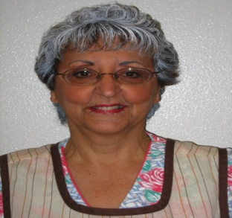
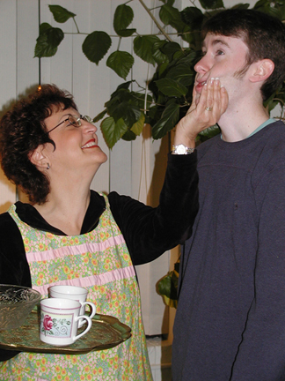
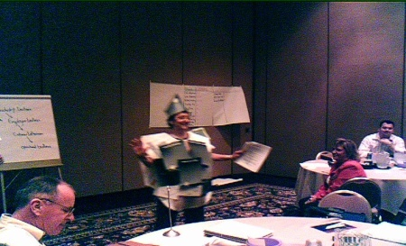
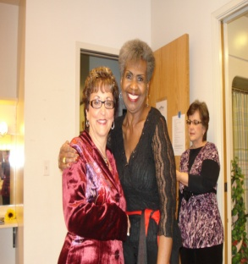
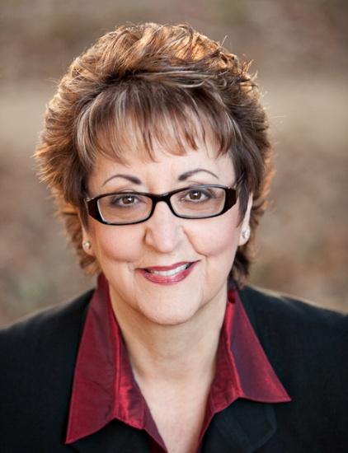
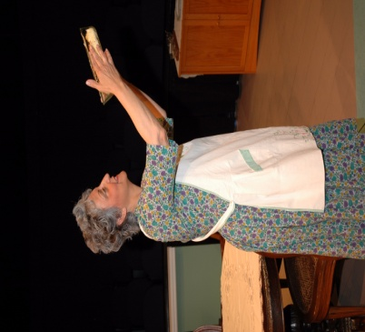
Who is Barb Turino?
Author
Actor
Consultant/Facilitator
Coach
Trainer
My role today?
Your role today?
Notes:
Who is Barb Turino?
My role today? Tell you my story. Challenge you to look outside the box
Opportunity to share some of my knowledge, wisdom (old enough), experiences and learnings
Personal Mission statement – learn (one thing) change your life and have fun
Why I wrote book and created workshops
Over 40 years successful in business in tandem w success in acting
My epiphany – mgr story
Cross over of skills – 10 skills
Voice nagging – write your book
Ignored voice for years until I couldn’t
Gave myself deadline of 1 year to completion
Started researching, collecting books, articles on my topic
Called a friend who was published
Advised me to write book proposal that he would present
Must have an agent to present prop to publishers
Took a long time
His agent had just published similar book but encouraged me to pursue
Spent months looking for am agent – some good feedback but no taker
Advice was to self publish
Worked with selfpublishing.com – spent over $3000
Made lots of mistakes but in the end I had a book I was proud of
Your role today? Ask yourself:
How does this apply to me and my life?
What can I do differently to improve and get results looking for? Insanity If nothing Changes – Nothing Changes

Slide 3



My Publishing Journey
Everyone has a book in them nagging at them to get out
Skip the hassle and self publish
Amazon is easiest little up-front cost
  Use fivver.com
Get good at Marketing
  Free Workshops, presentations
  BOR Sales
Notes:
For me the goal was to write the book and share it with people to fulfill my Mission Statement
Did not write to get rich, If that is your goal, look for more info
Book is my legacy – Like having a baby, sometimes painful but so worth it
Writing follow up geared to lay people and retirees
My advice after all time and money I spent – self publish with Amazon
To format for Amazon – cover & text – fivver.com - $25-$50

Slide 4

Notes:
Like to share one of my favorite skills that is use all the time.
For aspiring actors or authors these skills can be helpful
Comm is the key to success in life
I believe that when an indiv or group is effective in comm both
internally & externally with good listening & speaking skills
The results are amazing and endless
Coaches and therapists spend countless hours teaching effective comm
Harder that it sounds, takes dedication and practice, practice, practice

Slide 5
Verbal & Non-Verbal Communication
7% Words
38% Voice
55% Body Language
Notes:
Must learn to communicate well both verbally and non verbally
Non Verbal communication - body language has significant effect on what you actually communicate
versus what you want to communicate
Comm is:
7% Words
38% Voice
55% BL
Words – Careful of text & email
Tone – Fink, what do you think, clean clothes for nothing
Body language
Be aware of yours and study theirs
BL tells what we are really saying

Slide 6
Commas save lives !!!
Let’s eat Grandpa.
Let’s eat, Grandpa.
Notes:
Example written comm - Remember written communication also is important to success
Be mindful of your email and text correspondance – be sure it conveys your meaning and intention
Email & text - Have only words which is only 7% effective towards comm
Watch out for that punctuation – commas saves lives

Slide 7
Types of Learners/Decision Makers
Visual – 55%
Auditory – 20%
Kinesthetic – 25%
Notes:
70% of what people react to is based on visual input – exercise
Raise hand - Make fist
OK sign
Say – put hand on chin Do – put hand on cheek
3 types of learners, decision makers – Visual – 55%, Auditory – 20%, Kinesthetic – 25%
How do you know? Do exercise – 3 people on stge – one answers, 2 observe
Debrief
Brain science - Cannot do 2 things at once -
Cannot think and make eye contact
Eye movement exercise – V – Up, A – side, K – down right
Left – Remembering Right – Constructing
Handout – eye movement

Slide 8
Effective Listening
Active/effective listening is a skill which must be learned and practiced
Difficult to listen - we speak at a speed of 180 wpm and we have the ability to listen at 300-500 wpm
Listening with your motor running - just waiting for our turn to speak
Notes:
2 skills for successful comm – Listening & Speaking
Today – Listening - Active listening & feedback - Discuss bullets
When speaking you cannot be listening
In saying too much you hear too little
Exercise & Debrief:
Pair up – 1 min. Life story
Have listener repeat back and speaker checks for understanding.

Slide 9
To Listen Effectively
Listen twice as much as talk
Only interrupt for clarification
Listen as if you will have to feedback what heard
Feedback to check for understanding
Observe body language
Make eye contact
Seek First To Understand Then To Be Understood
Steven Covey
Notes:
Listening is an ACTIVE not passive process
Take notes if need to – ask permission
It must be practiced

Slide 10


ACT
We all have two ears and one mouth—and we should use them in that proportion.
When you are speaking, you are only learning what you already know.
Notes:
Remember – read slide

Slide 11
Actor’s Critical Tip
You aren’t really listening unless you are willing to be changed by what you hear
Dr. Redford Williams - Lifeskills

Slide 12
Speaking Exercise
Rules: You may not ask questions.
Draw two parallel lines.
At one end of those parallel lines, connect the lines with an upside-down V as in Victor.
Connect the other end of the parallel lines with a straight line.
From one of the sides of the upside-down V, draw two more parallel lines.
Connect one end of these lines with
a straight line.
Look at each other’s drawings.
Debrief
Notes:
Conduct exercise
Debrief:
#1 try - Whose fault all failed?
#2 - Allow & encourage questions (good ques, TY)
Story – college students (80% afraid to ask Q in fear of looking stupid) – no stupid questions
#3 – all succeed
Goal/outcome clear Covey – Begin with the end in mind
Behavior was modeled
Ques enc & rewared
Practice these tools and find more in the book to help be a successful communicator

Slide 13
Effective Speaking
Describe outcome desired
Allow and encourage questions
Model the behavior you want
Notes:
Tell goal, outcome, what you want them to do
Encourage questions
Demonstrate of model behavior you are looking for

Slide 14
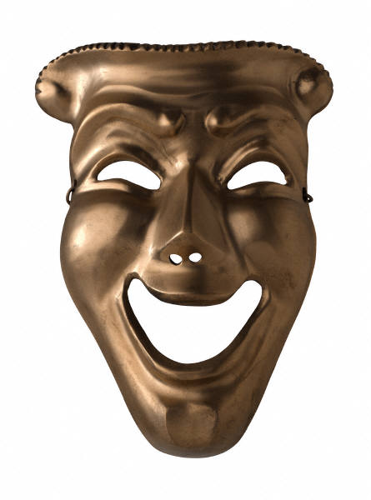
Actor’s Critical Tip
Use the skills the actor uses
on your own stage—
the stage of life.

