Slide 1
We are all Storytellers!
“The history of our grandparents is remembered not with rose petals but in the laughter and tears of their children and their children’s children. It is into us that the lives of the grandparents have gone. It is in us that their history becomes a future.” - Charles and Ann Morse

Slide 2
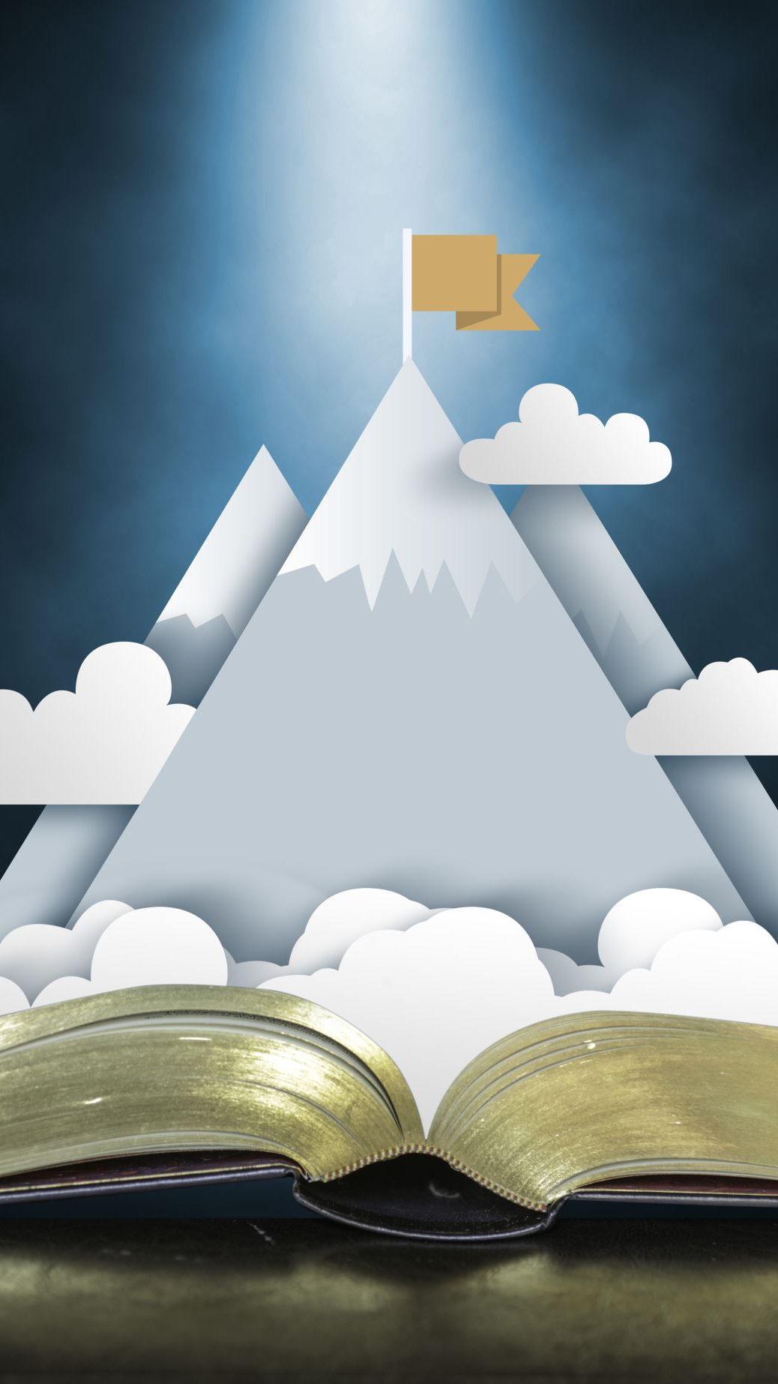
Discover your Ancestors story, Discover your Story
TIP # 1
Let’s “Turn the hearts of the Father’s to the children and turn the hearts of the children to their fathers.”
Through sharing our stories
-Malachi 4:6

Slide 3
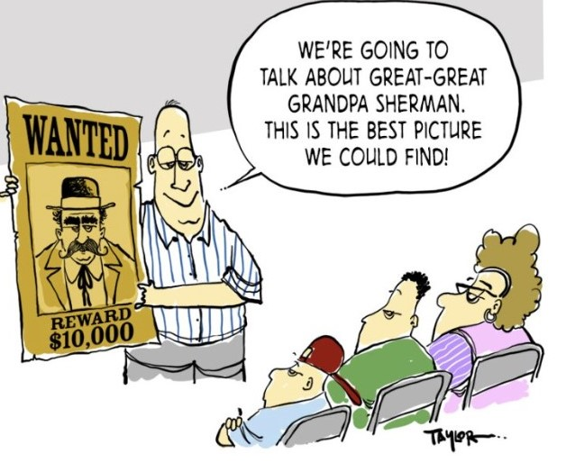
WHO IS LISTENING?

Slide 4
Tip # 2 Bite size pieces

Slide 5
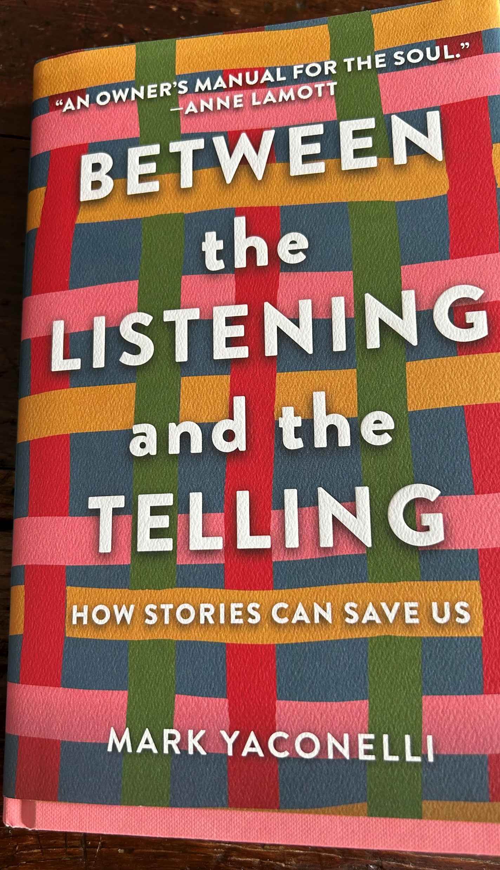
tip # 3
Good Story Tellers are good Story Listeners
Ask questions
Round 1

Slide 6
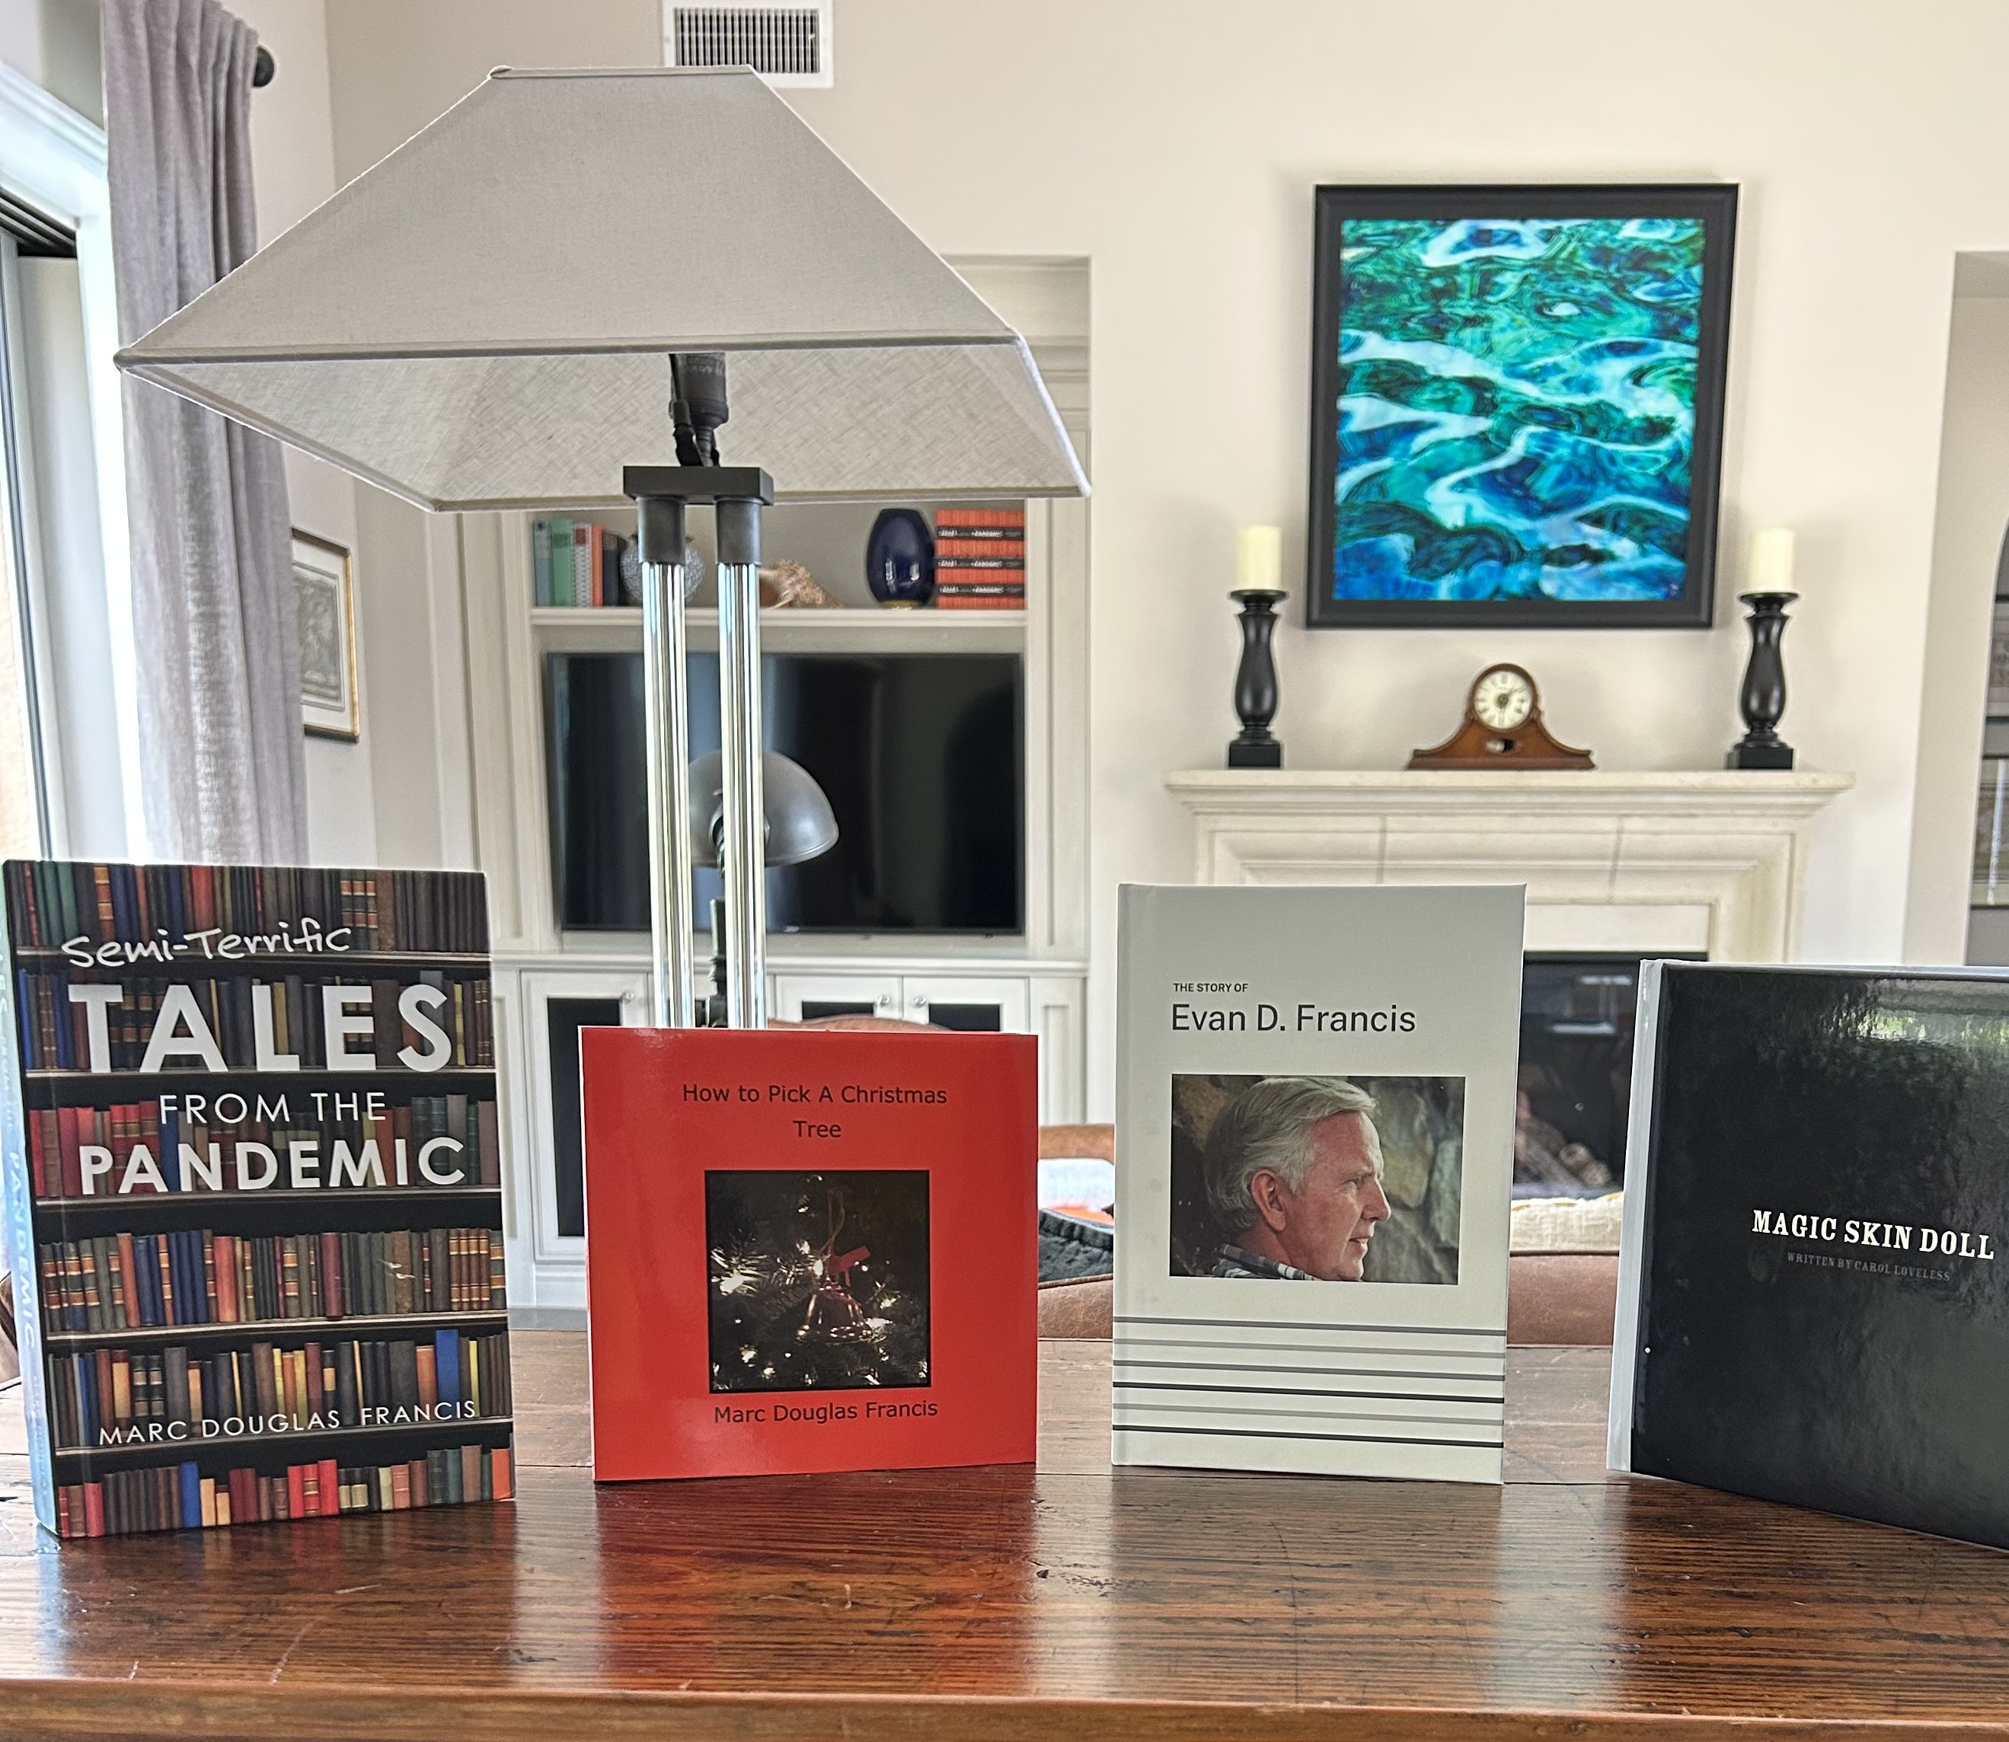
Lots of ways to listen and tell
Tip #4
Write a book
Round 2

Slide 7
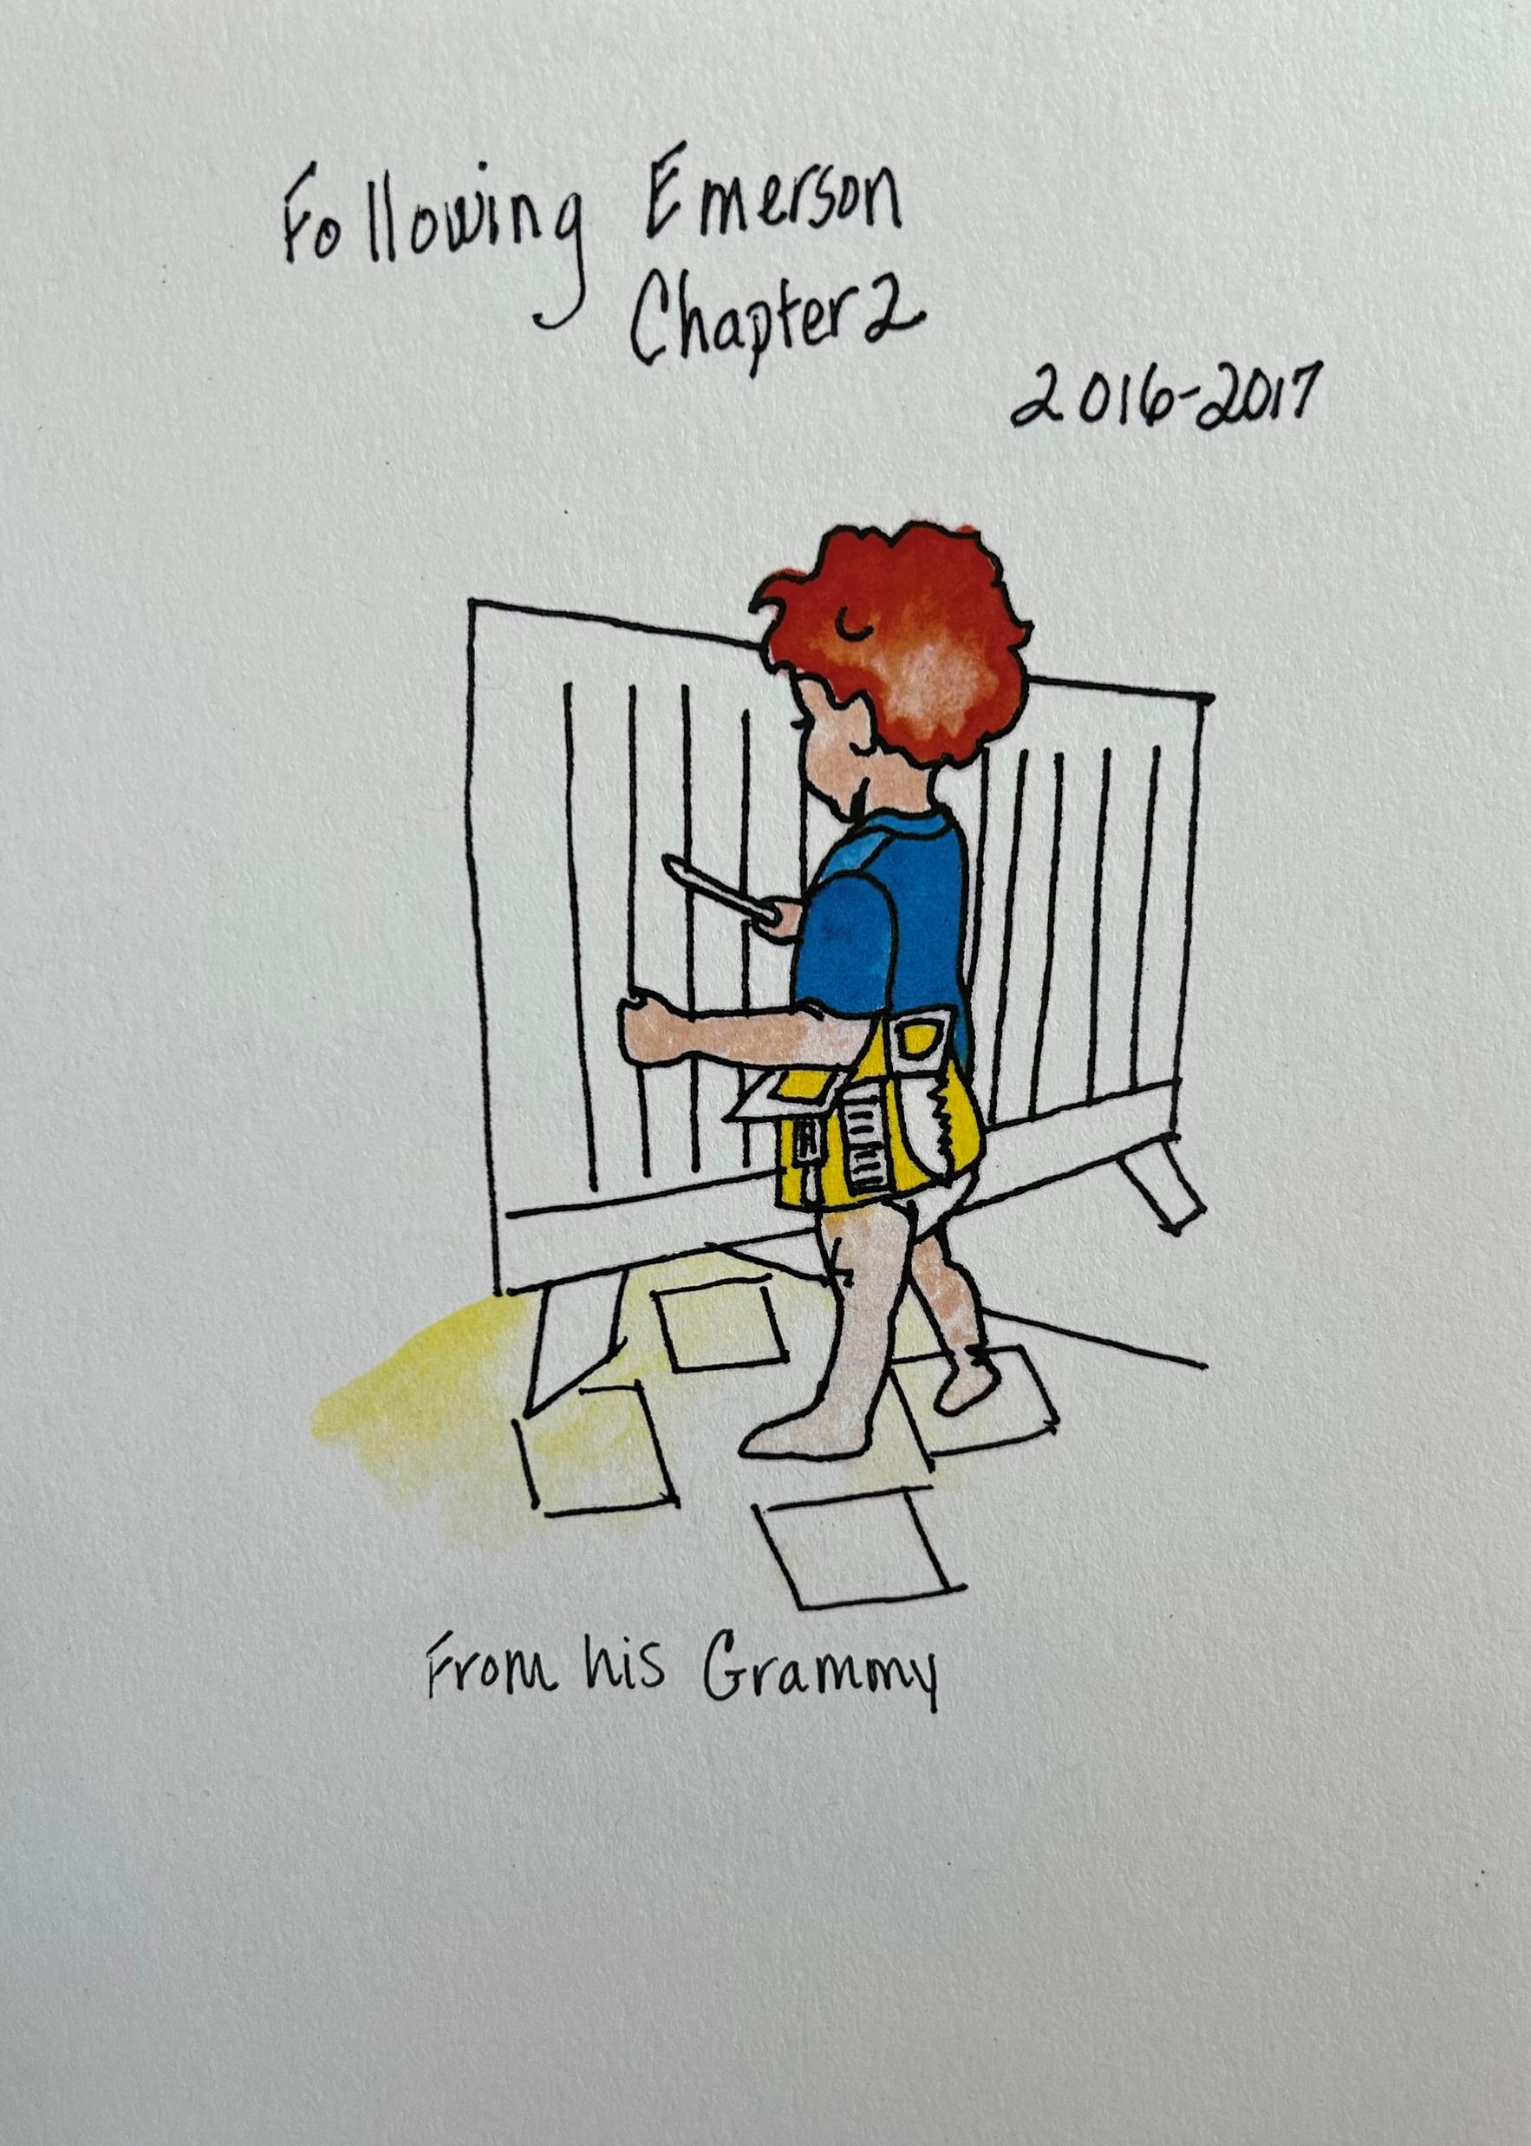
Tip #5 “Tell Me Story!”
“ABOUT WHO?”
“ABOUT ME!!”

Slide 8
Tip #6 Involve Your family

Slide 9
Help your grandkids know and tell their family’s stories
Round 3

Slide 10
6 good reasons to Tell your family’s his--Story HER-- sTORY Your-Story
Creates healthy Intergenerational self
Unlike Social Media, it helps us discover true stories of significance
Connects and binds us to family past, present, future
Creates a vehicle for healing, forgiveness and compassion
Helps us uncover our identities
It is what glues us all together
“Everything is held together with stories . . .”That is all that is holding us together, stories and compassion.” -Barry Lopez, Winter Count
.

Slide 11
Knowing your Family’s history creates more resilient humans
The more children knew about their family’s history, the stronger their sense of control over their lives, the higher their self-esteem and the more successfully they believed their families functioned. The “Do You Know?” scale turned out to be the best single predictor of children’s emotional health and happiness.
"The Stories That Bind Us" in The New York Times 2013 – Bruce Feiler

Slide 12
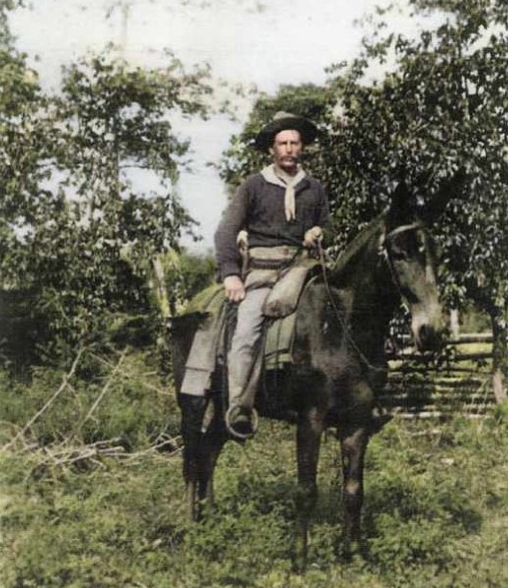
“We all grow up with the weight of history on us. Our ancestors’ dwell in the attics of our brains as they do in the chains of knowledge hidden in every cell of our bodies.” – Shirley Abbot
Tip # 7
Create traditions of
storytelling
Round 4

Slide 13
“You’re never alone, even during what you think are your weakest moments. You have thousands of years of powerful ANCESTORS within you… Infinite strength is always on tap for you. Know that!”

Slide 14
TIP #8
SHARE WITH YOUR FAMILY
On the Family Search App

Slide 15
How can Family Search - Help you connect and belong to family – past, present, Future? help you tell your story? Help you tell your Family Story?

